Slide 1
CIFAR10 Image Classification
Name: Lim Ming An
Admission no: 2102511I
Class: P01

Slide 2
Introduction
CIFAR10 is popular and widely used image classification benchmark dataset for computer vision learning.
It consists of 60,000 color images of size 32x32. The images are divided into 10 classes which are airplanes, automobiles, birds, cats, deer, dogs, frogs, horses, ships, and trucks.
50,000 images are used for training and 10,000 images are used for testing.

Slide 3


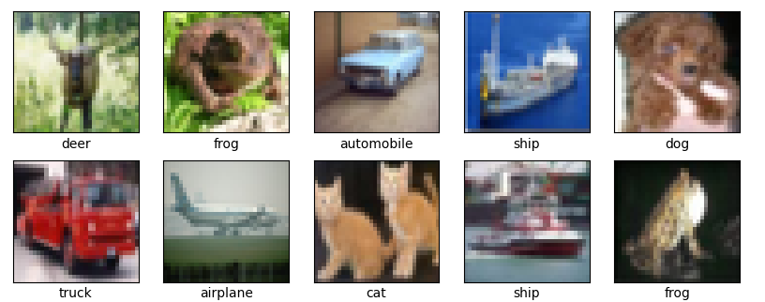


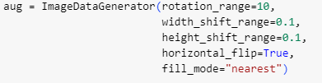
Data exploration:
The data are separated into X and Y for both training and testing datasets. The values are stored in sets of arrays
X contains RGB values that ranges from 0 to 255. There are 3 sets of arrays for each image since there are 3 color channels.
Y contains values that ranges from 0-9. Each number represents the class that the image belongs to
Preprocessing techniques:
Convert values to float
Pixel normalization - divide each instance in X dataset by 255 so that all the image pixels are between 0 and 1. Used in Lenet5 and AlexNet
Standardization – subtract mean and divides by standard deviation (STD). This ensures zero mean and STD of 1. Used in ResNet and GoogleNet
Label Binarizer – convert all classes to 0 except the correct corresponded class which will be a 1. Used in all model
Data Augmentation - generates variations of images from the dataset to provide more training samples for the model to learn
We can also see the distribution of images.
Training set contains 5000 images for each class, which makes up the 50,000 images mentioned
Testing set contains 1000 images for each class, making up 10000 images in total

Slide 4

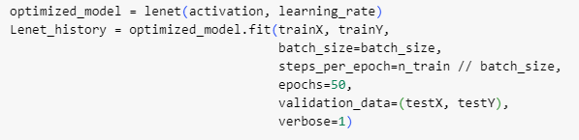

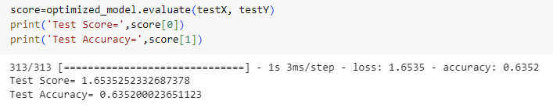
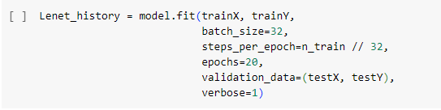
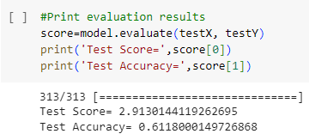
LeNet model building:
The architecture is made of 3 convolution layers with max pooling and 2 fully connected layers.
The model is compiled using accuracy as the metric. The optimizer used is Adam and the loss function used is categorical crossentropy.
LeNet fine tuning using Bayesian Optimization:
Parameters that were chosen for fine tuning were type of activation function (RELU, Sigmoid and tanH), learning rate(0.001 to 0.003) and batch size (32 to 128)
The optimizer was run for 9 iterations, meaning 9 models were built, all with different parameters.
The best parameters are:
Results found are all rounded up to their nearest value. Hence the final parameters are:
Model was then rebuilt using these parameters. The number of epochs increases to 50 to allow model a longer time to run. These are the final results:
We can see that there is a minor improvement to the model’s test accuracy from 0.611 to 0.635.
We can also see that the test score was able to decrease significantly from 2.91 to 1.65. Overall, our fine-tuned model was able to perform much better.
Base LeNet settings and results:
Base LeNet uses RELU as its activation function and a learning rate of 0.001.
The model is then fitted using batch size of 32 and ran for 20 epochs.
The model was able to get a test accuracy of 0.611 and test score (loss) of 2.91.

Slide 5
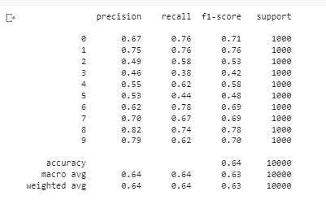
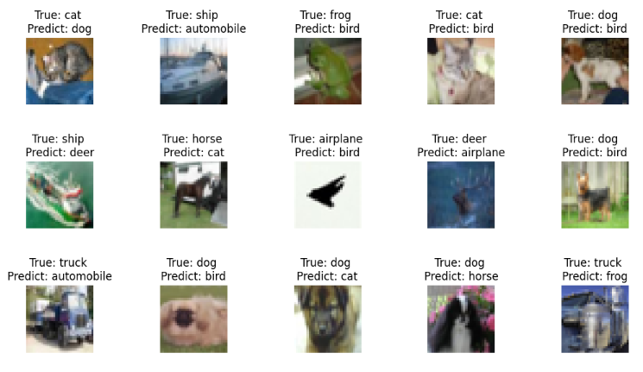
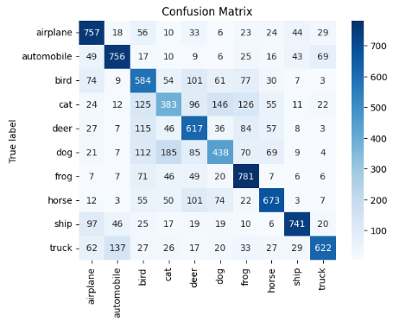
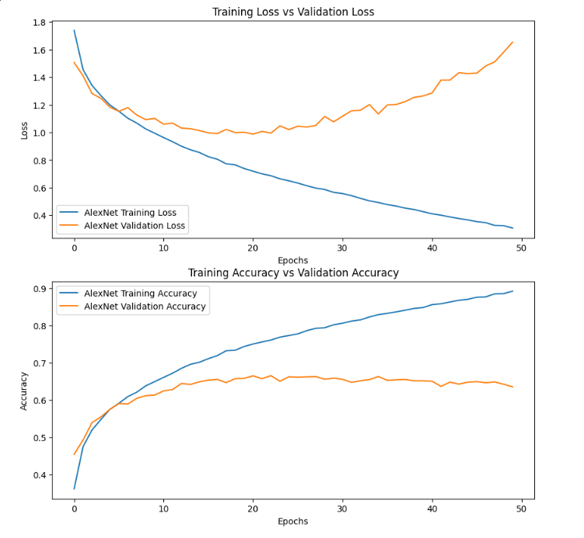

Slide 6

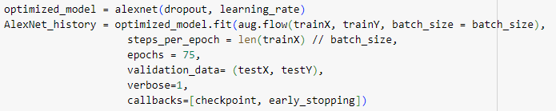
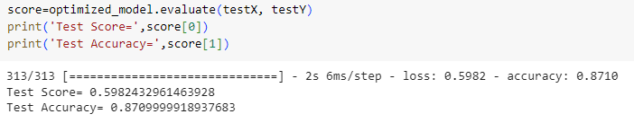
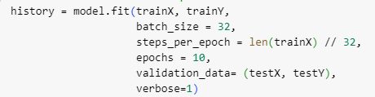

AlexNet model building:
The architecture is made of 5 convolution layers with max pooling and dropout and 3 fully connected layers.
The model included L2 regularizer used to prevent overfitting
The model is compiled using accuracy as the metric. The optimizer used is Adam and the loss function used is categorical crossentropy, same as LeNet
AlexNet fine tuning using Bayesian Optimization:
Parameters that were chosen for fine tuning were dropout(0.1 to 0.5), learning rate(0.003 to 0.005) and batch size (32 to 64)
The optimizer was run for 9 iterations.
The best and final parameters are:
Additionally, data augmentation was done here as optimization. Model should be able to perform better with more training samples. The number of epochs increases to 75. These are the final results:
We can see that there is a significant improvement to the model’s test accuracy from 0.789 to 0.870. The model was able to classify almost 10% more accurately.
We can also see that the test score was able to decrease from 0.739 to 0.598. Overall, our model improved
Base AlexNet settings and results:
Base AlexNet uses a dropout of 0.3 and a learning rate of 0.003
The model is then fitted using batch size of 32 and ran for 10 epochs.
The number of epochs is lesser than LeNet because AlexNet has a much more complex architecture and takes a longer running time. This would also help save time during fine tuning process
The model was able to get a test accuracy of 0.789 and test score (loss) of 0.739

Slide 7
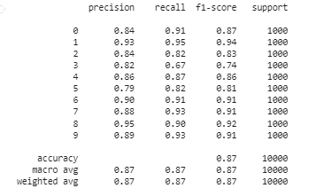
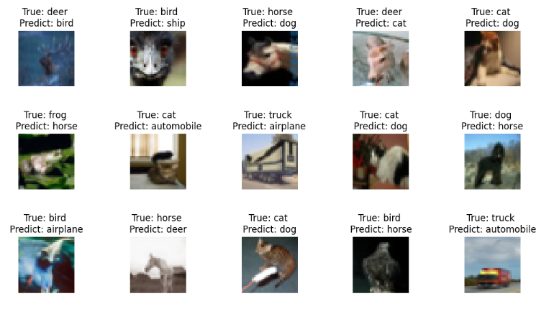
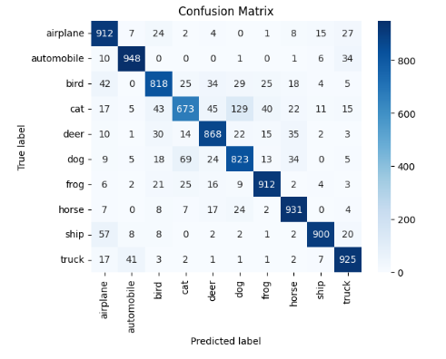
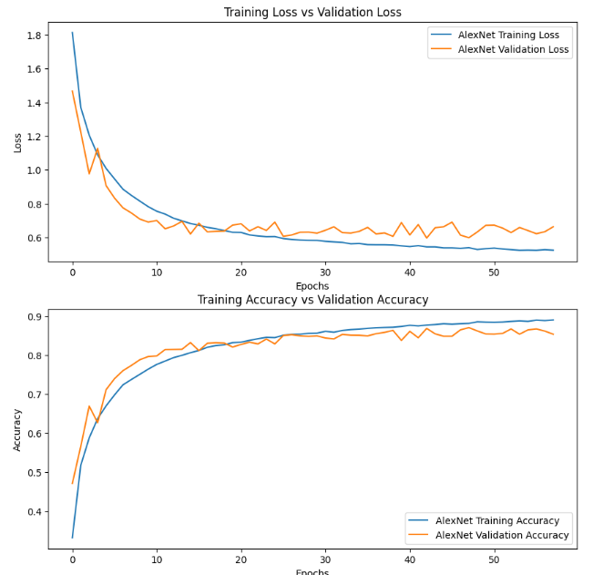

Slide 8


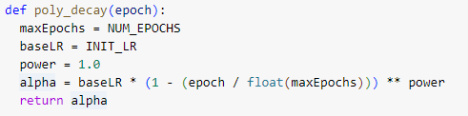
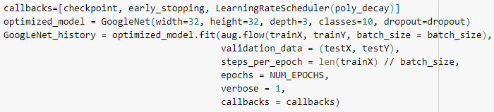
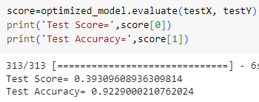
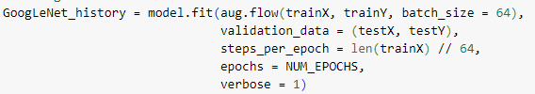
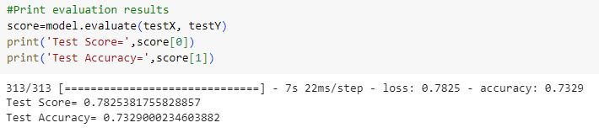
GoogleNet model building:
The architecture is made of 9 inception modules as well as 2 down-sample modules. The inception modules consist of max pooling, 1x1, 3x3 and 5x5 kernels. Batch normalization is also included as each convolution layer.
The model is compiled using accuracy as the metric. The optimizer used is SGD and the loss function used is categorical crossentropy
GoogleNet fine tuning using Bayesian Optimization:
Parameters that were chosen for fine tuning were dropout(0.3 to 0.7) and batch size (32 to 256). The optimizer was run for 5 iterations.
The best and final parameters are:
Additionally, learning rate was optimized in a different way using a scheduler, which decreases the learning rate in a polynomial manner as the number of epochs increases. The point of this is to avoid the model from oscillating too far away from the minima during the backpropagation gradient descent process.
Model was then rebuilt using the parameters with a learning rate scheduler passed as callback. Number of epochs was increased to 120. These are the final results:
We can see that there is a significant improvement to the model’s test accuracy from 0.732 to 0.922. This is due to the increase in number of epochs and learning rate scheduler.
We can also see that the test score was able to decrease from 0.782 to 0.393, a decrease in half. Our model is able to classify more than 90 percent of the images, which is very good.
Base AlexNet settings and results:
Base GoogleNet uses a dropout of 0.5 and a constant learning rate of 0.0005
The model is then fitted using batch size of 64 and ran for 10 epochs.
The model was able to get a test accuracy of 0.732 and test score (loss) of 0.782

Slide 9
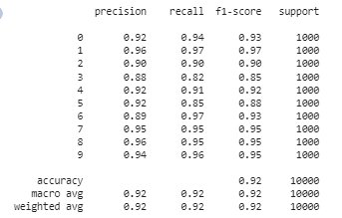
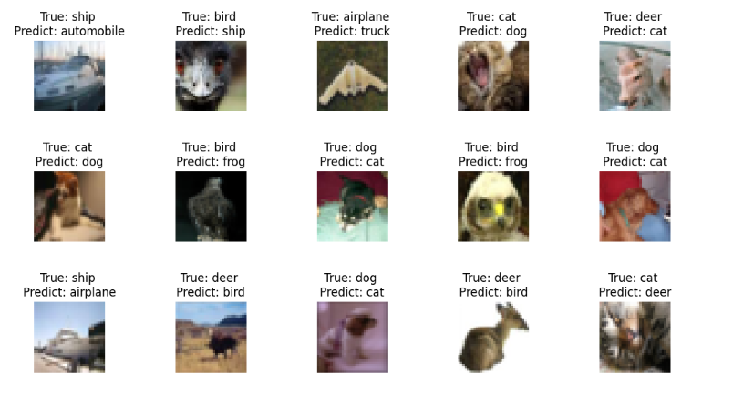
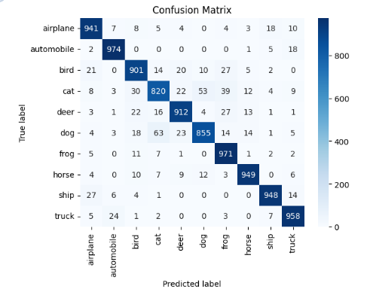
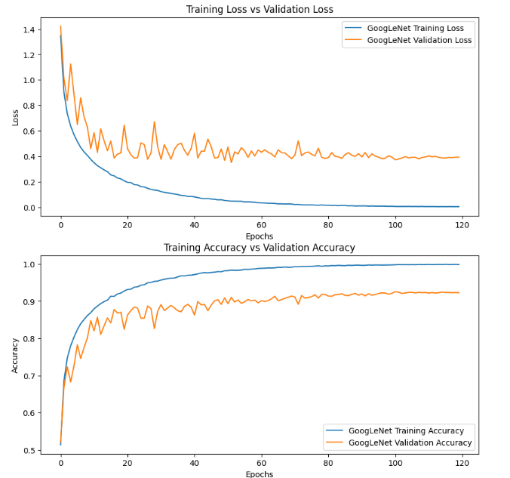

Slide 10


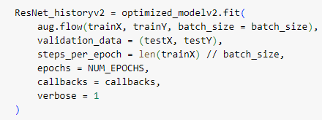
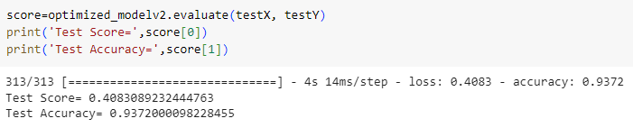
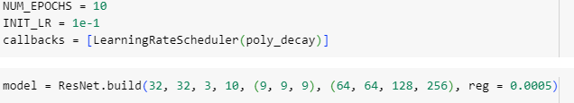
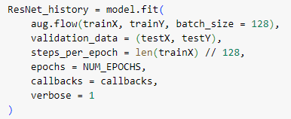
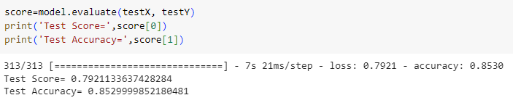
ResNet model building:
The architecture is made of 9 residual blocks that contains 3 convolution layers of 1x1, 3x3 and 1x1 kernels respectively and batch normalization layers. This results in a final architecture of 56 layers, often referred to as ResNet56
The model is compiled using accuracy as the metric. The optimizer used is SGD with a momentum of 0.9 and the loss function used is categorical crossentropy
GoogleNet fine tuning using Bayesian Optimization:
Parameters that were chosen for fine tuning were regularization rate (0.0001 to 0.0005) and batch size (64 to 256). The optimizer was run for 6 iterations.
The best and final parameters are:
Additionally, after the model was ran for 100 epochs, I noticed the validation accuracy was still improving, hence I saved the model and continue training for another 20 epochs.
The final results are:
We can see that there is a significant improvement to the model’s test accuracy from 0.852 to 0.9372. This result actually matches the original ResNet tested on CIFAR10 in the research paper by He et al
We can also see that the test score was able to decrease from 0.792 to 0.408. This is our best model out of all. Hence I will use it for android deployment
Base ResNet settings and results:
Base ResNet uses a regularization rate of 0.0005. The number of filters within the convolutional layers are (64, 64, 128, 256)
The model is then fitted using batch size of 128 and ran for 10 epochs.
The model was able to get a test accuracy of 0.852 and test score (loss) of 0.792

Slide 11
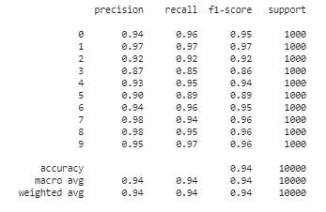
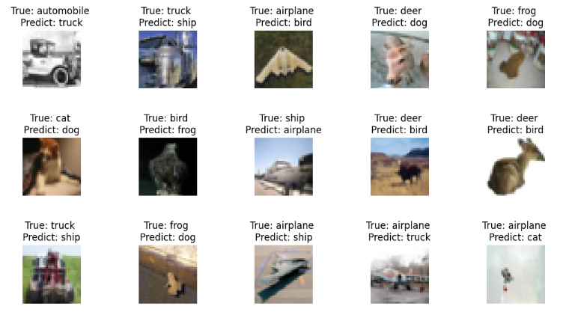
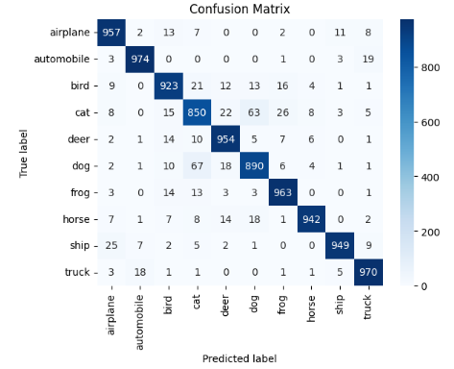
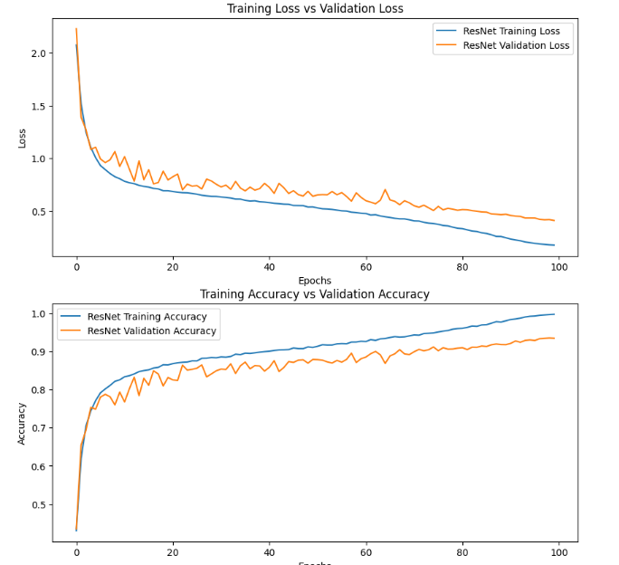

Slide 12
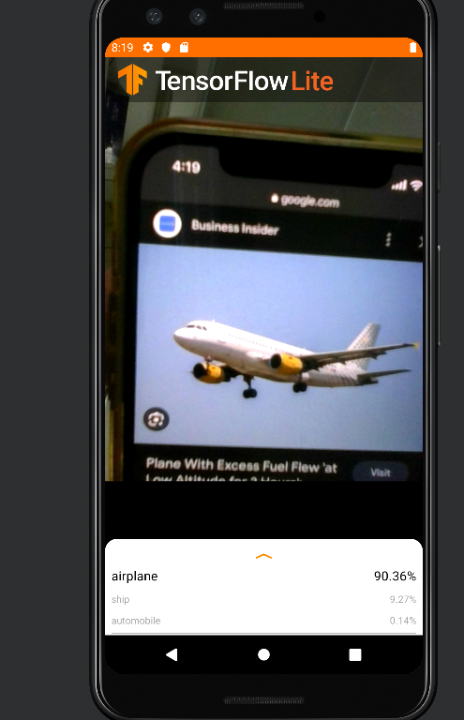
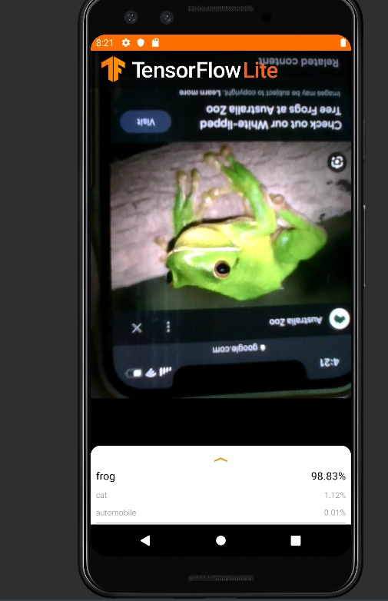
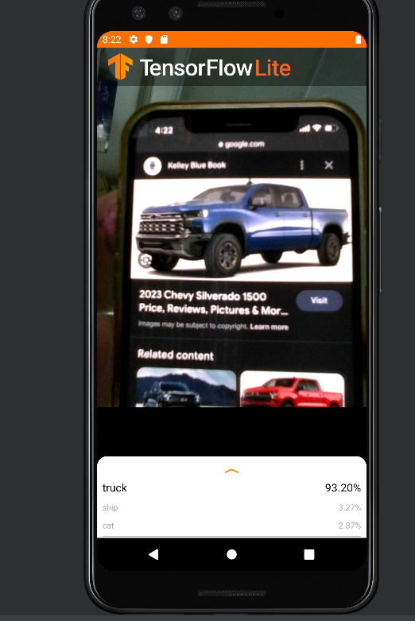
Android deployment

Slide 13
Conclusion
Computational resources was a problem, since GoogleColab provides a limit to the RAM and GPU. Therefore, when running Bayesian Optimization, not a lot of parameters were fully explored and there is low number of iterations. Models also took a very long time to train there were cases where training was interrupted due to running out of RAM and the training had to be restarted over again
For future work, I would like to try GoogleColab Pro and explore more models such as vision transformers (ViT). I would also like to explore other optimization method such as GridSearch.

